Slide 1
AChemS Codefest 1.0 --- Pyrfume
Wed April 20th - orientation
John McGann (program chair)
Joel Mainland (leader)
Jake Saunders (teacher)
Evan Guerra (teacher)
Valentina Parma (teacher)
Emily Mayhew (teacher)
Mackenzie Hannum (teacher)
Casey Trimmer (teacher)
Ha Nguyen (teacher)
Vince Ramirez (teacher)
Danielle Reed (cheerleader)
Katie Bell
Sarah Socia
David Huang
Mike Rizzo
Eduardo Martin-Lopez
Hillary Cansler
Isabelle Cullen
Paule Joseph
Alissa Smethers
Shuwi Yu (spelling)
Marissa Kamarck
Jérémie Topin
Matej Hladis
Jeevan Tewari
Hsiu-Yi Lu
Cecilia Bouachi
Ashley Loeven
Stephanie Brener
Jane Parker
Nicholas Blum
Sabastein Fiorucci
Khushbu Agarwal
Jessica Brann
Jonas Junge
Justice Lu
Italics = submitted graphs and/or code

Slide 2
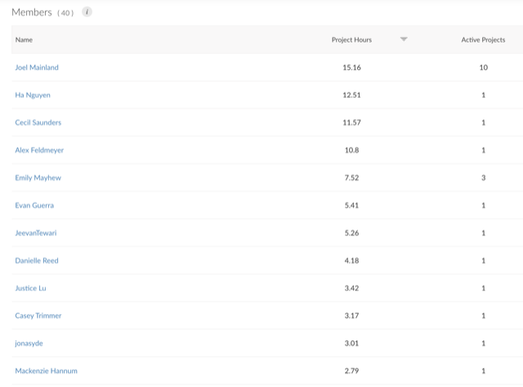
RStudio Cloud reports that participants put in 61.1 hours of coding just yesterday (116 overall), with 35 active members.
Here is the leaderboard for number of hours coding overall (not just yesterday):

Slide 3
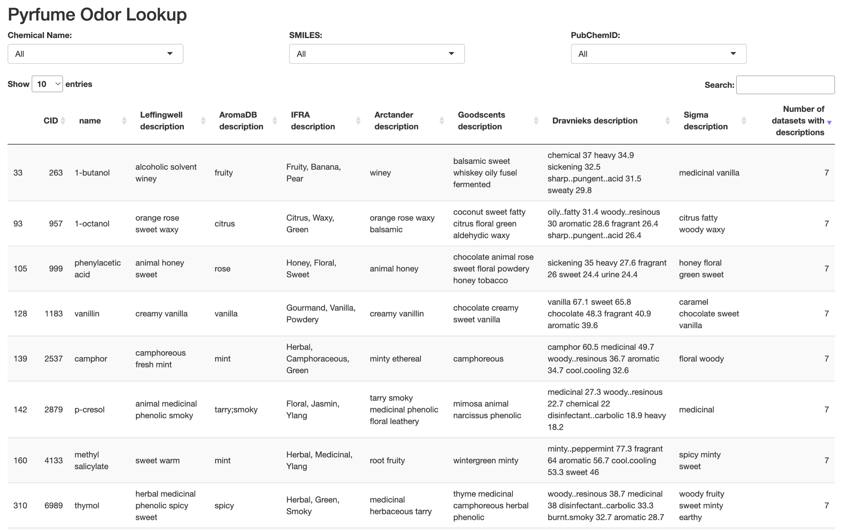
Joel Mainland

Slide 4
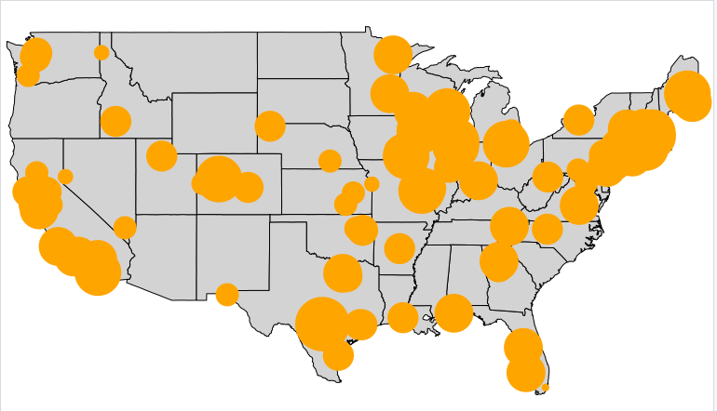
Evan Guerra

Slide 5
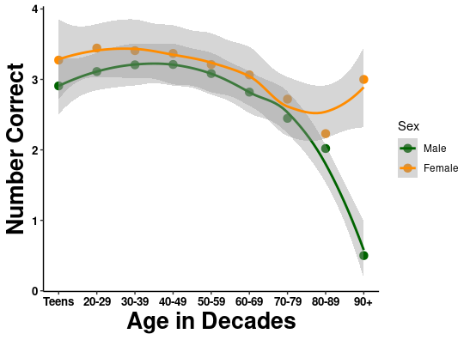
Valentina Parma

Slide 6
Mackenzie Hannum

Slide 7
Paule Joseph

Slide 8
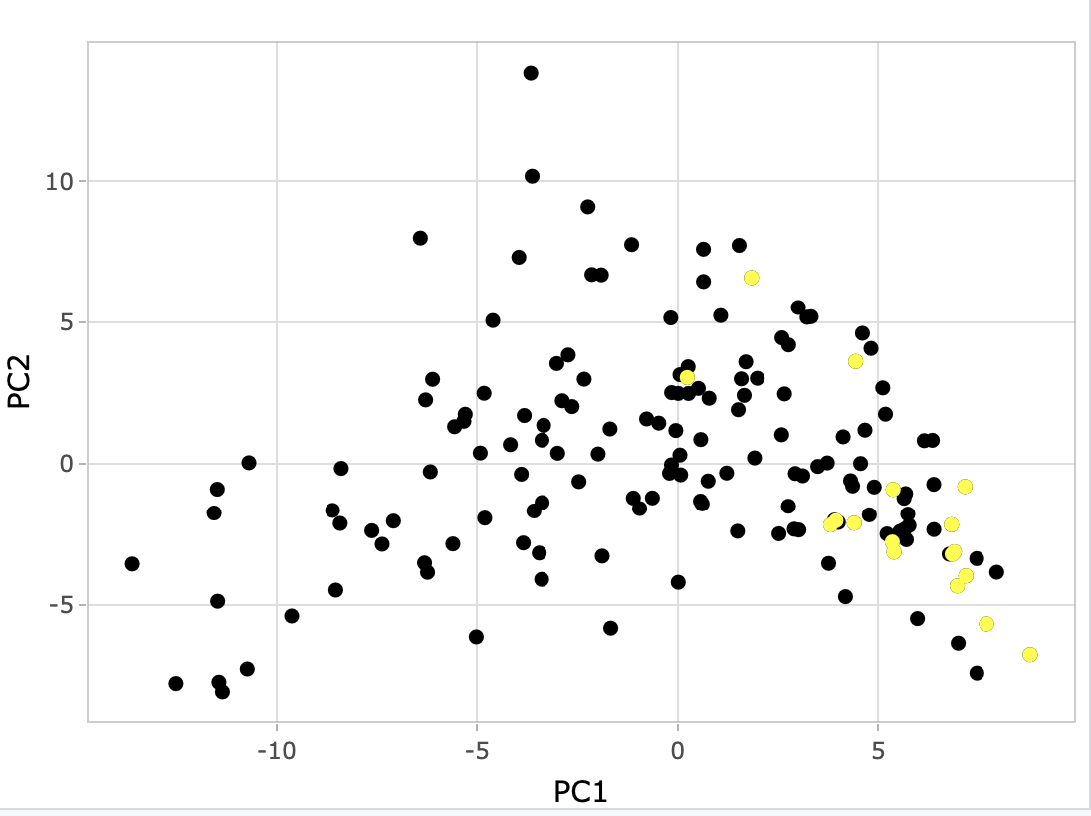
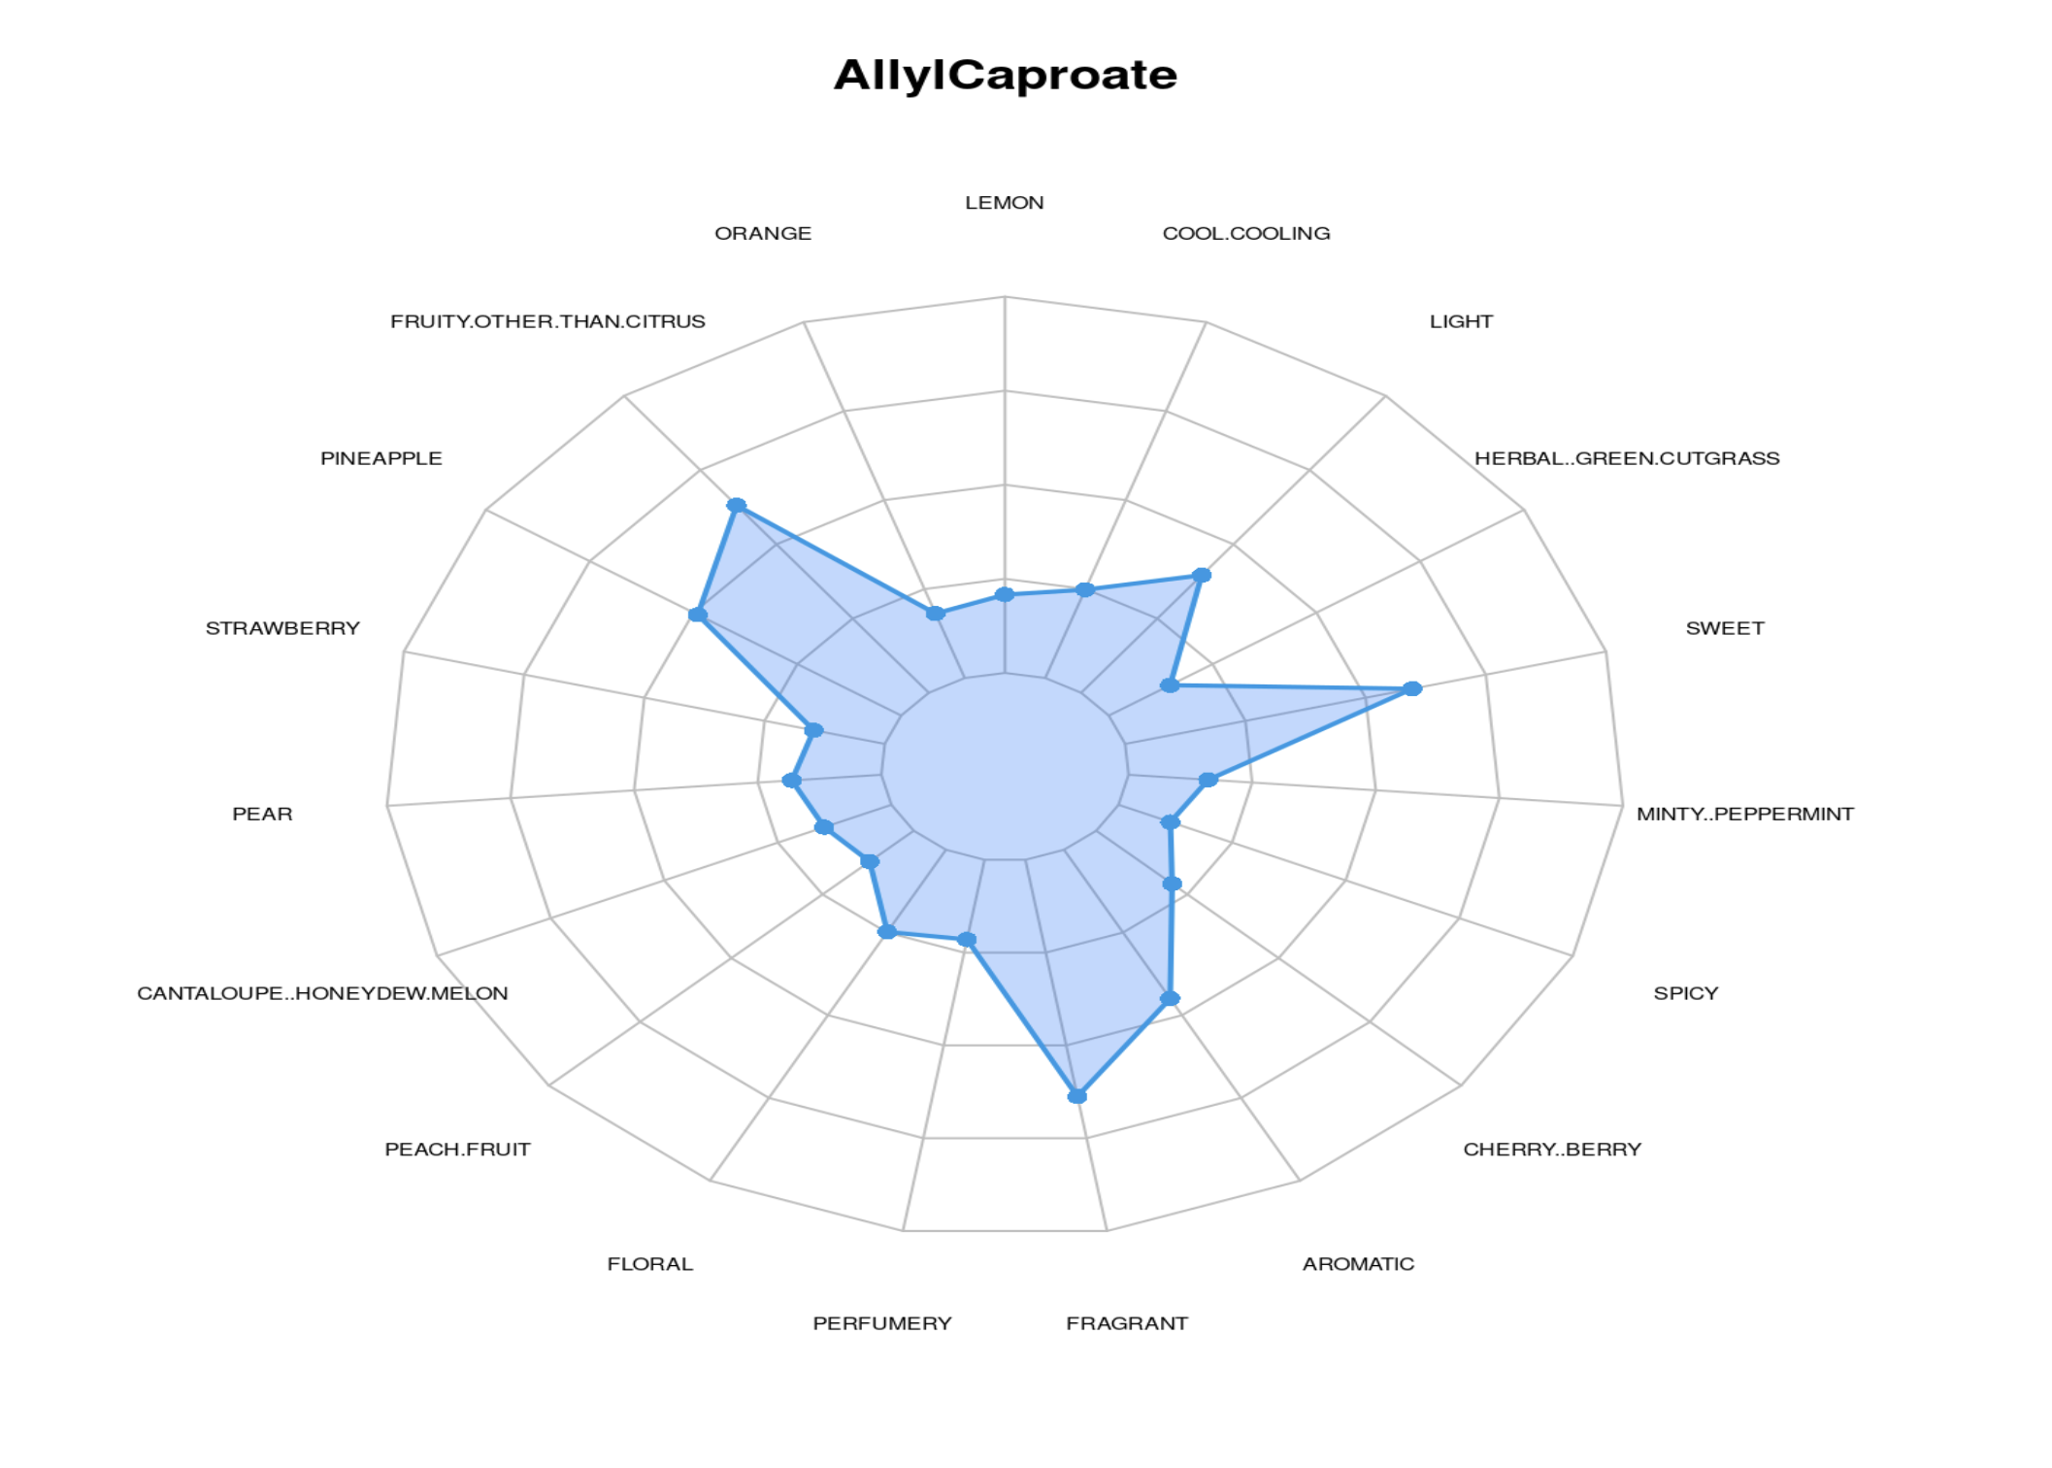
Stephanie Brener

Slide 9
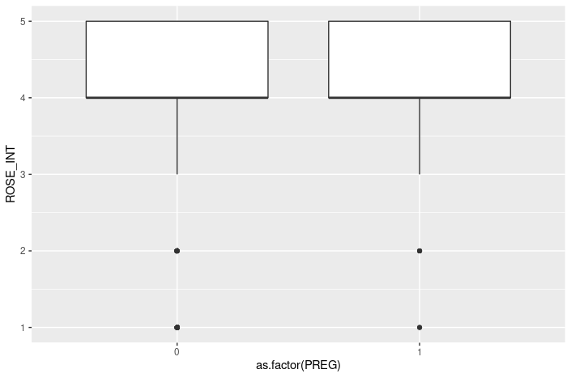
Khushbu Agarwal

Slide 10
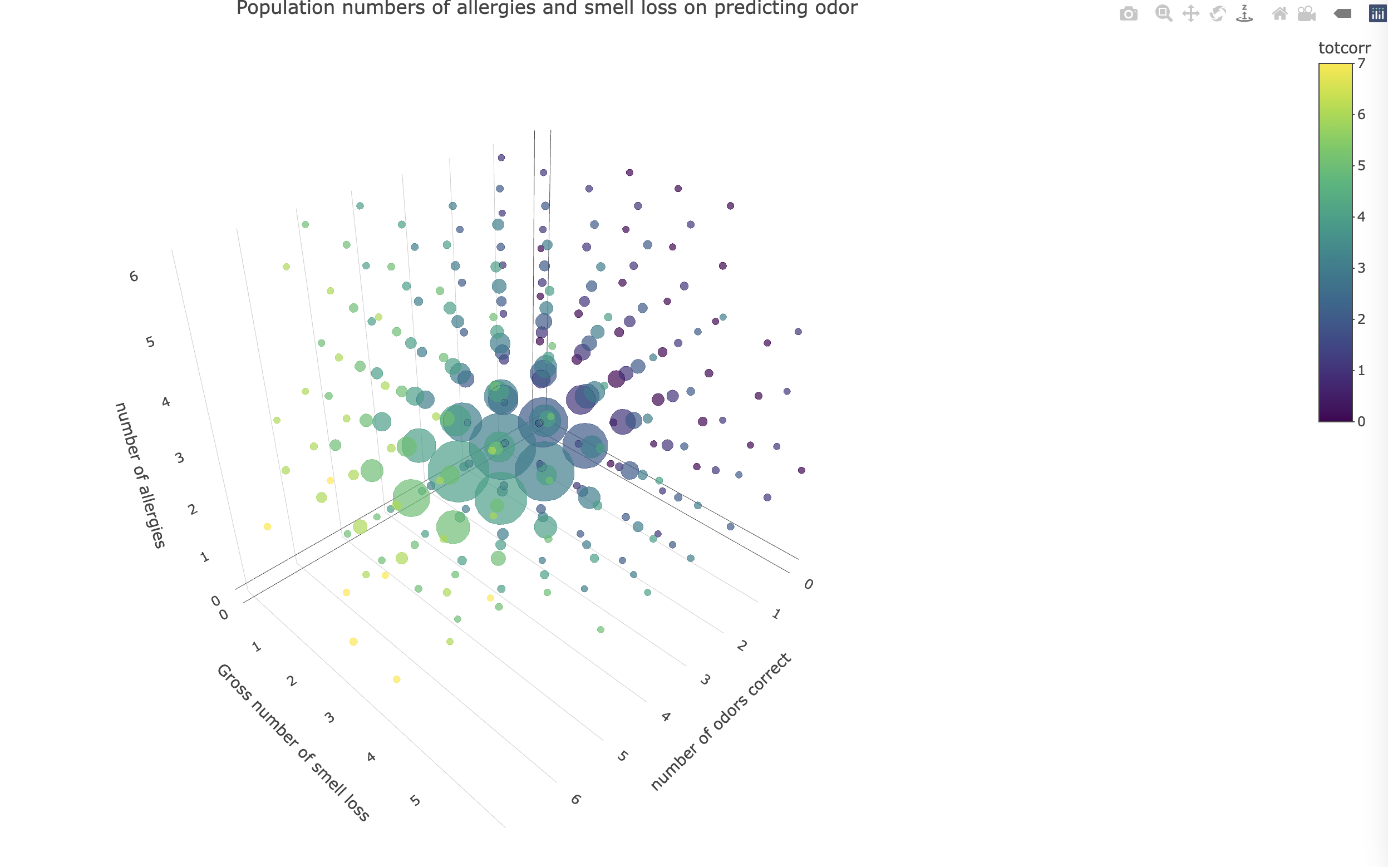
Justice Lu

Slide 11
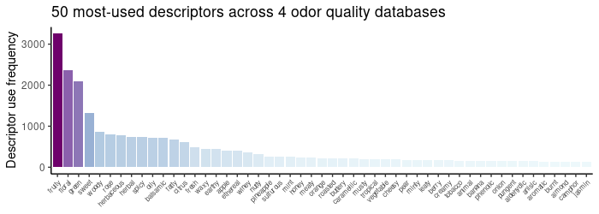
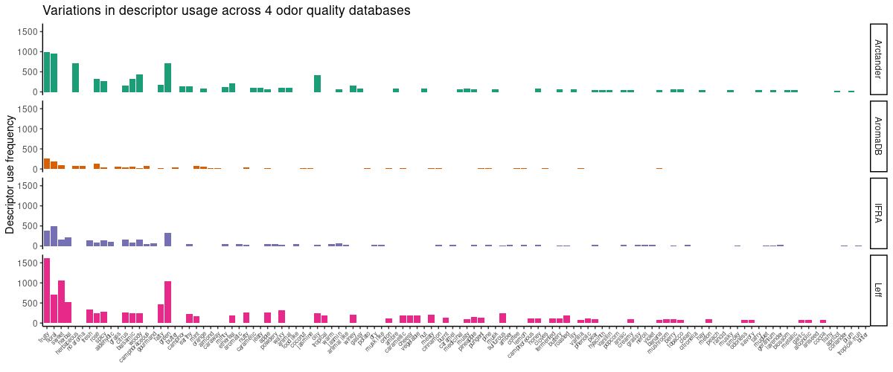
Emily Mayhew

Slide 12
Ha Nguyen

Slide 13
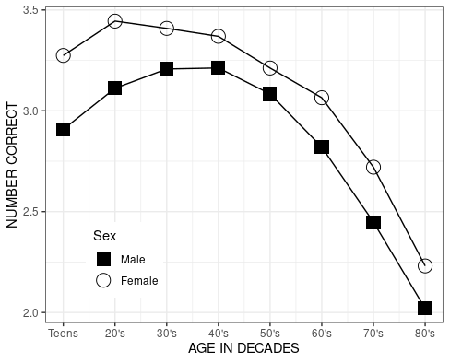
Danielle Reed

Slide 14
Marissa Kamarck

Slide 15
Jeevan Tewari

Slide 16
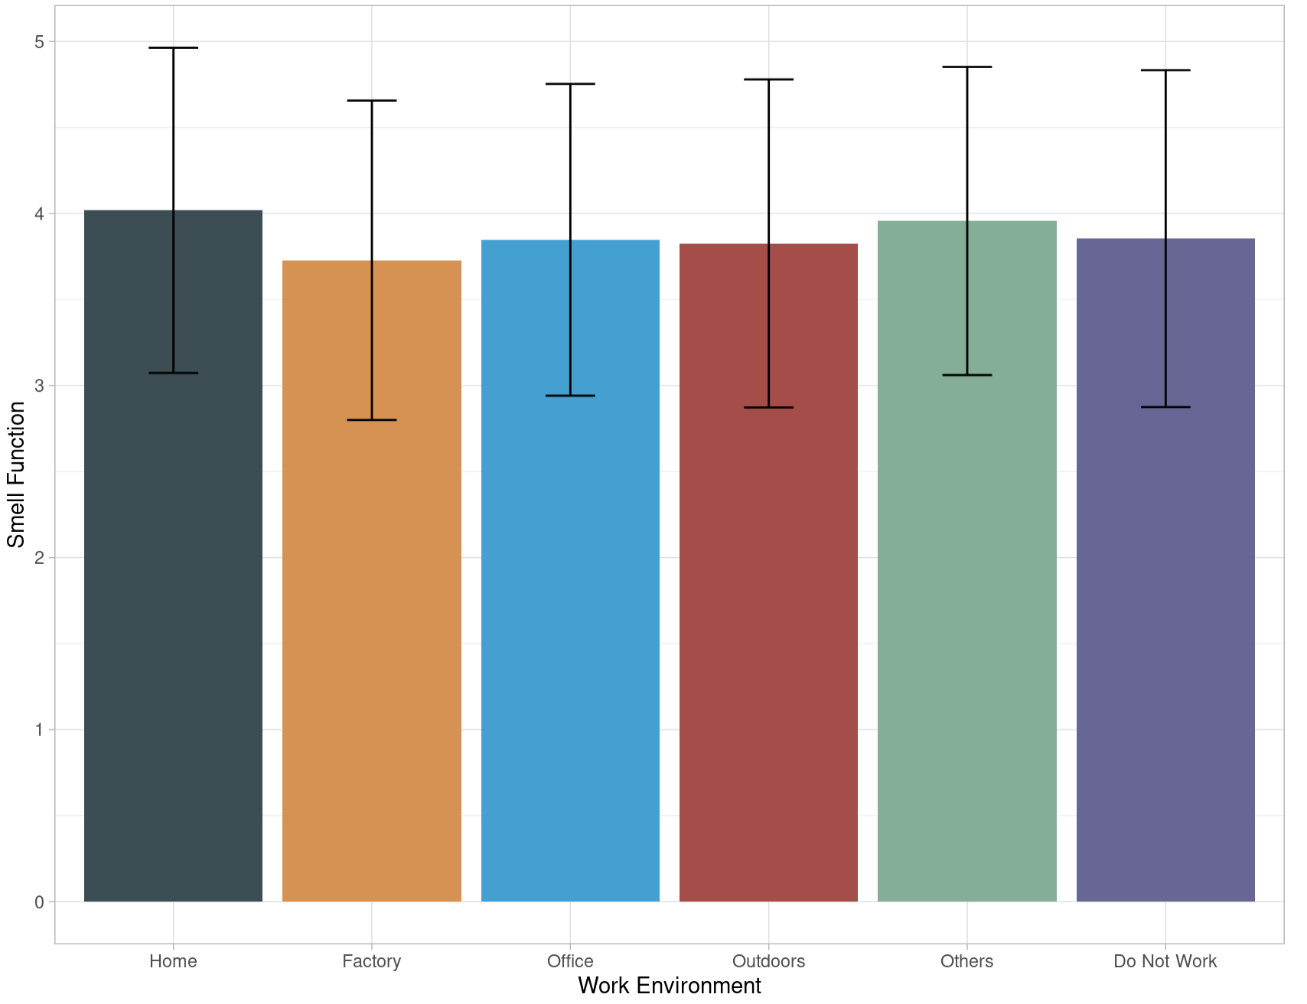
May Cheung

Slide 17
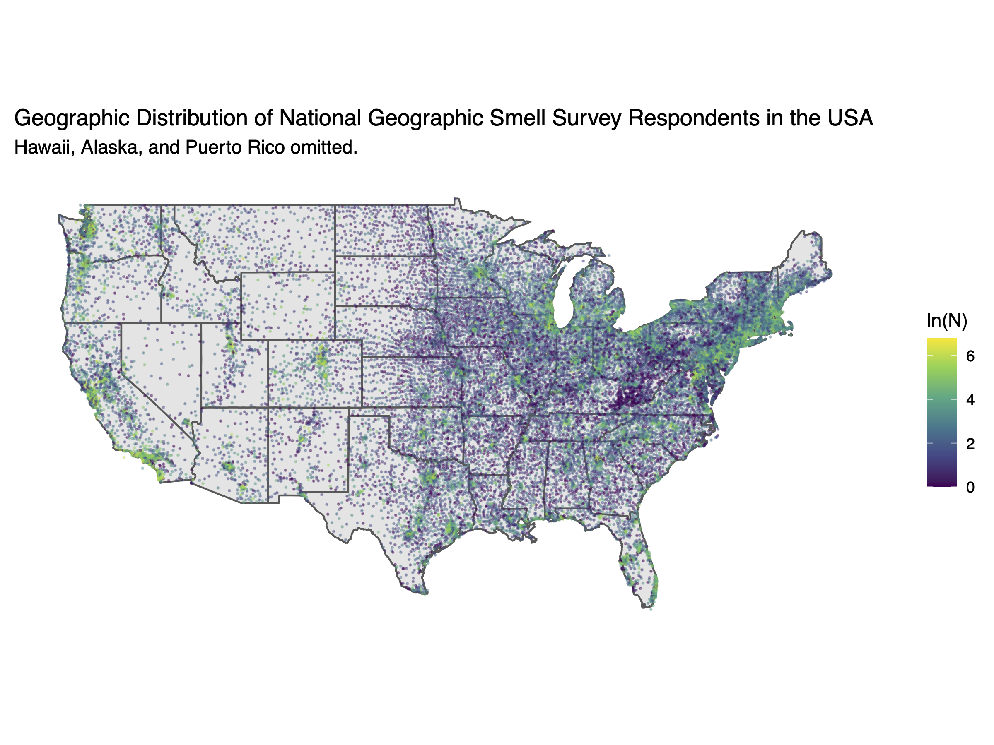
Vince Ramirez

Slide 18
Casey Trimmer

Slide 19
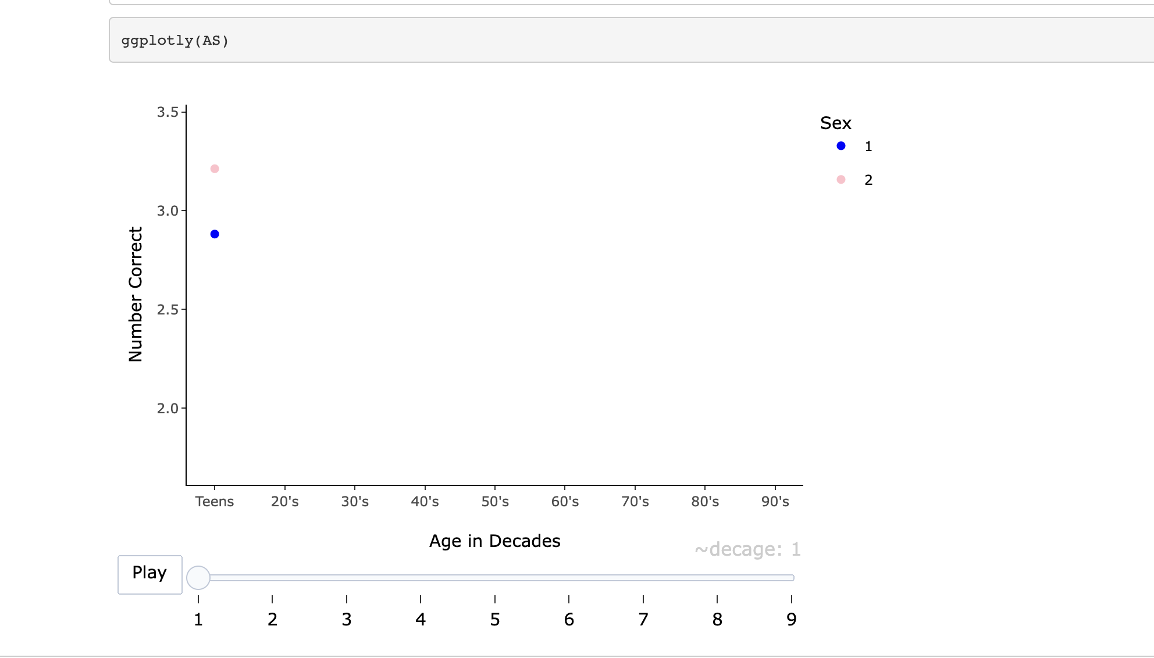
Alissa Smethers
Plotly

Slide 20
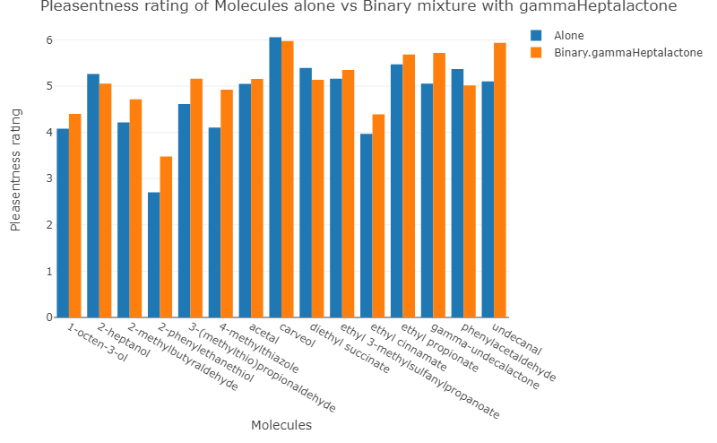
Dhirendra Singh Gehlot

Slide 21
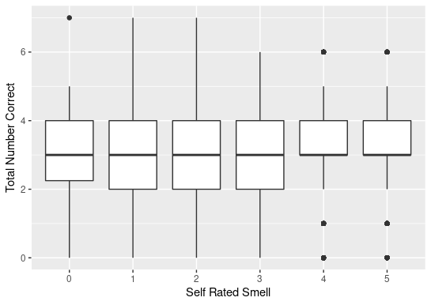
Steph Hunter

